Slide 1







Data Mining to Identify At-Risk Genetic and Rare Diseases Patients
Daniel Moynihan

Slide 2
Introduction
How can we leverage EHR data to:
Identify rare disease patients?
Fine-tune rare disease red flags?
Proof of concept
Limitations
Potential

Slide 3

Methodology – Data Security
Office of Insights and Analytics, High-Performance Computer lab
Database secured in a network-disabled computer, in a room with security cameras and restricted access

Slide 4

Methodology – Preliminary Data Examination
Health Catalyst’s Population Builder tool used to identify patients of interest (1.28M total patients)
Allows for filtering on multiple parameters
Patient
Age
Gender
Race
Problem List
Problem code
Problem description
Labs
Description
Max/Min value
Date
Drugs
Description
Dispensed/ Ordered
Dosage
Imaging
Presence of certain phenotypes (e.g., cardiomegaly)

Slide 5

Methodology – Value Sets
Using Systematized Nomenclature of Medicine Clinical Terms (SNOMED) codes, however there are multiple codes referring to the same disease. Thus, we created value sets, which puts all such codes into a bucket to be easily selected.
Familial Hyperlipidemia
Familial Hyperlipidaemia
…
Genetic Counselling
Genetic Counseling
…
Familial Hypercholesterolemia
Genetic Testing

Slide 6

Methodology – Data Wrangling
Need to get specific data of interest/use for answering our questions.
Pull data out of database
SQL queries to extract certain fields
Clean data so it can be used effectively
RStudio programming
Remove NULL/NA fields
Convert datatypes

Slide 7

Methodology – Data Analysis
All analyses took place in the RStudio environment.
Installed certain packages and their dependencies, which takes longer than normal in an airlocked computer lab
The data allowed for these methods of analysis
Visualisation
Box plots
Scatter plots
Bar graphs
Statistical testing
Two sample t-test
Machine learning
Cluster analysis

Slide 8

Fabry Disease
Multisystemic genetic disease
Rare but treatable
Diagnosis often takes time
Most patients are in contact with multiple specialists due to the distributed nature of the disease
Can we build tools to shorten the diagnostic odyssey?

Slide 9
Fabry Disease – Diagnostic Criteria
A patient is flagged as suspect if they satisfy the following conditions, provided by subject matter experts (SME)
1. Less than 50 years old
AND
2. Symptoms from AT LEAST two of the following systems
Kidney
Chronic kidney disease
Proteinuria
Microalbuminuria
Cardiac
Cardiomyopathy
Valvular heart disease
Arrhythmia
Neuro
Stroke ischemic
Transient ischemic attack
Acroparaesthesia
Skin
Angiokeratomas
Impaired sweating/hypohidrosis
Heat and cold intolerance
Eye
Corneal whirling
Cornea verticillata
Corneal and lenticular opacities
Vasculopathy (retina, conjunctiva)
2,213 suspects identified, along with 4 true positives (TPs)
TPs = Patients with anything from Fabry Disease value set in their problem list
(Jan 2023)

Slide 10
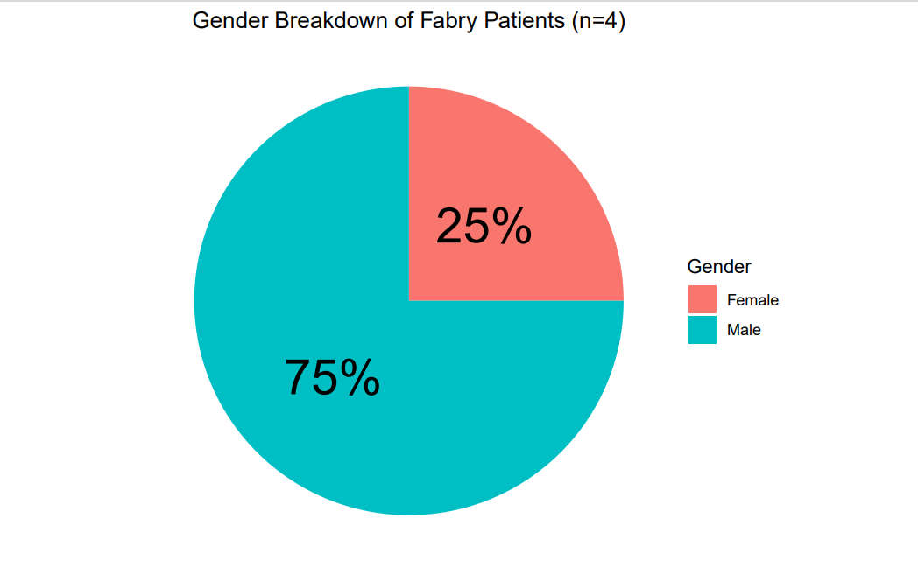
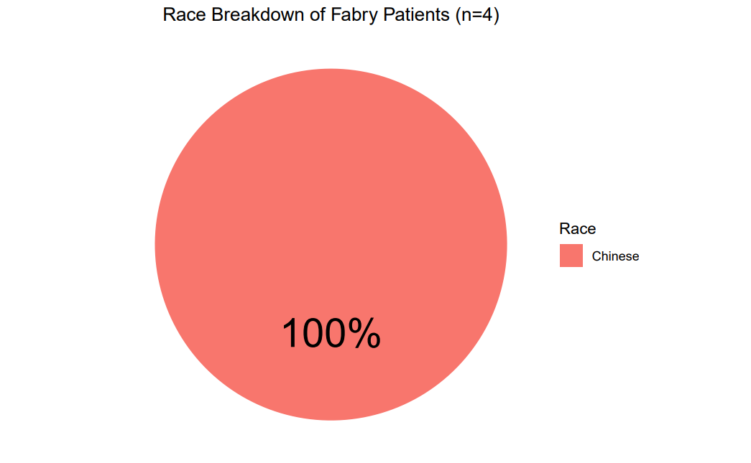
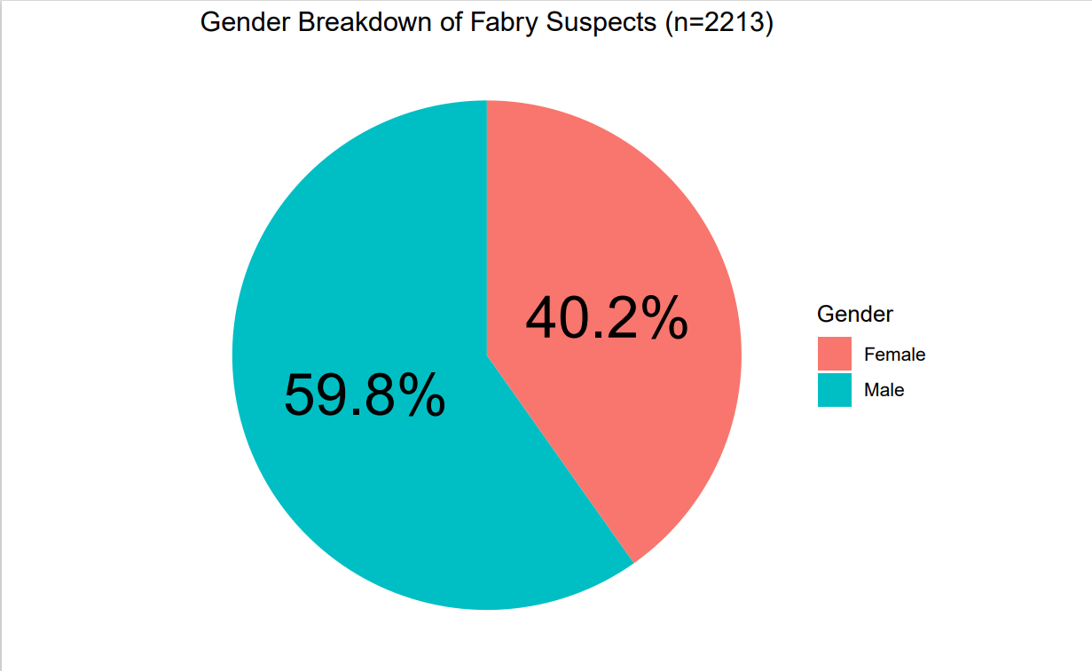
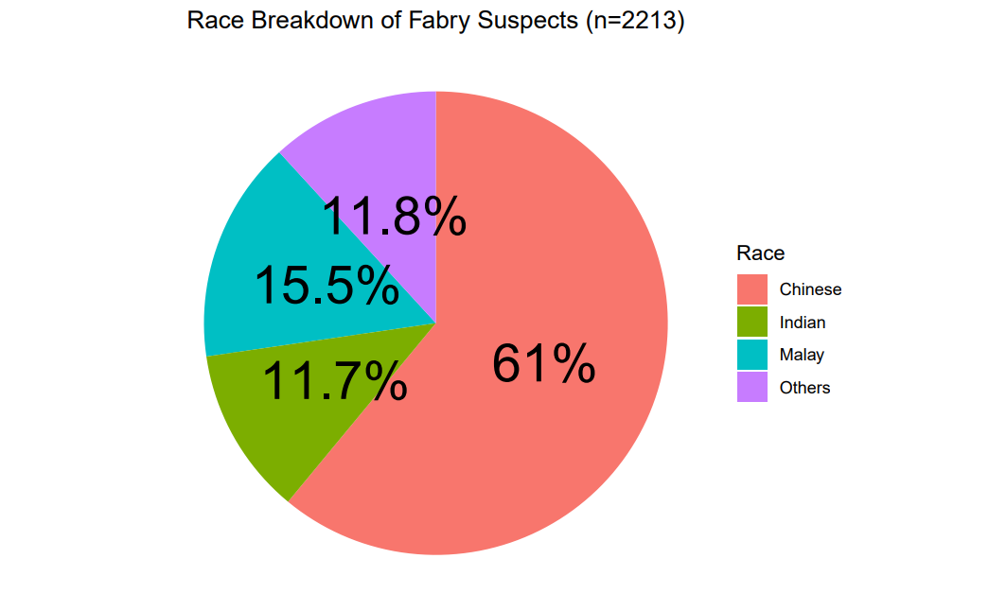
Fabry Disease – Demographics
Can compare true positive and suspect demographics
TP
Suspect

Slide 11
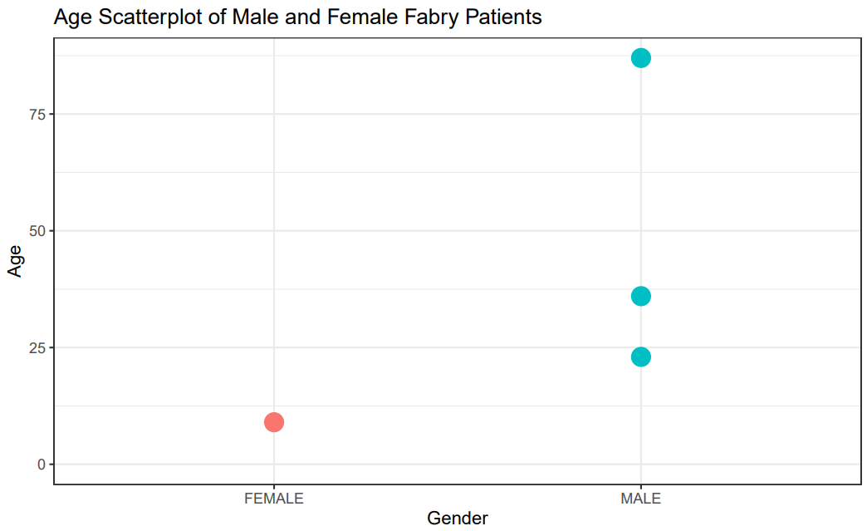
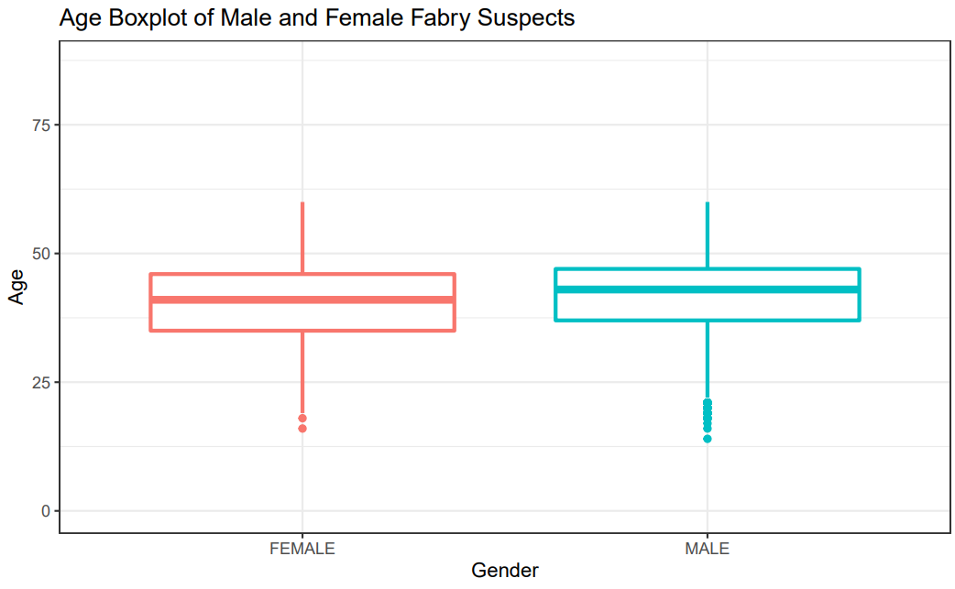
Fabry Disease – Demographics

Slide 12
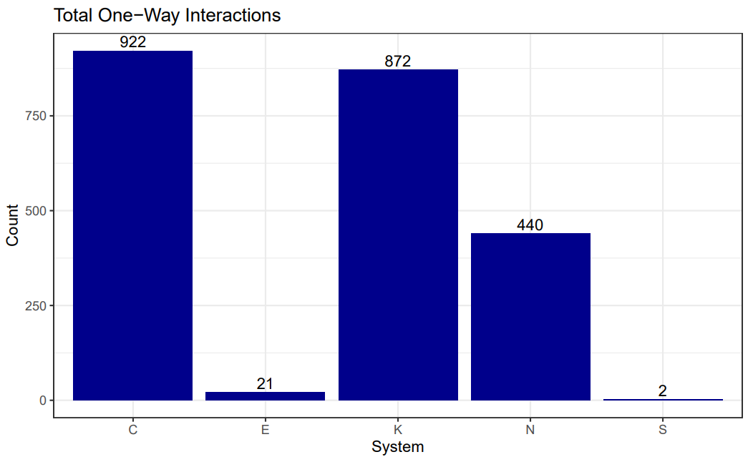
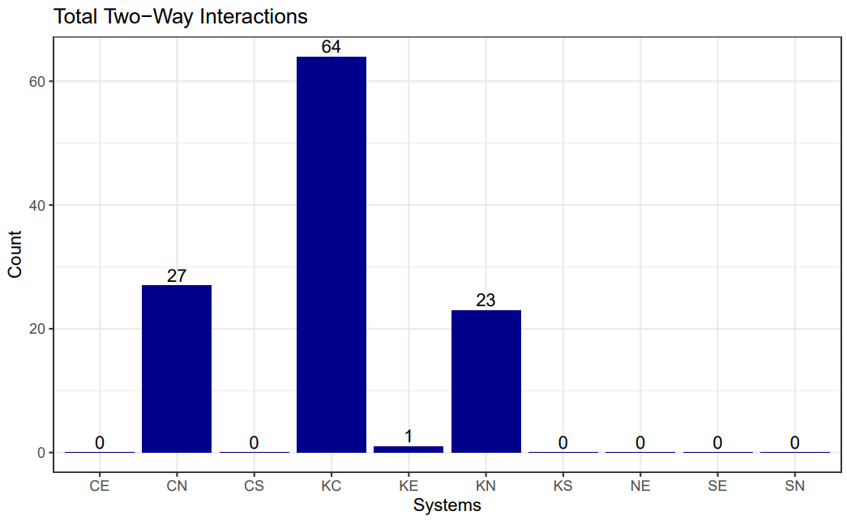
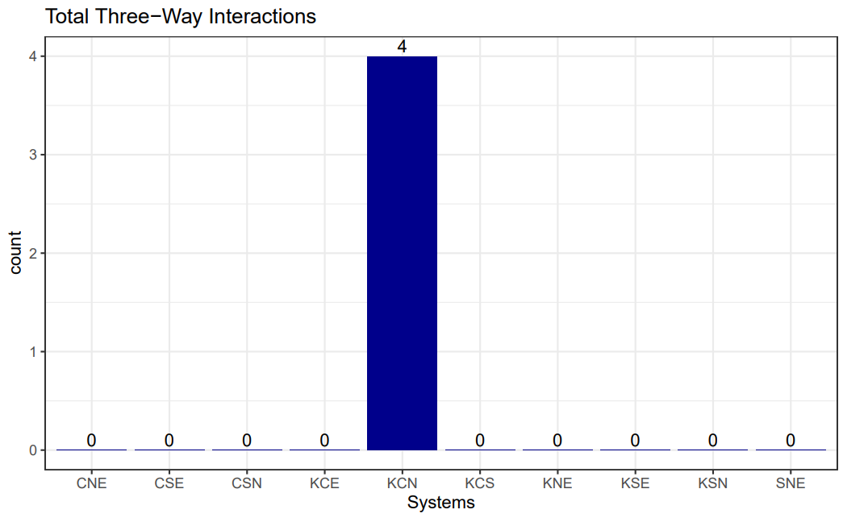
Fabry Disease – System Interactions
Useful to examine the distribution of affected systems in suspects
C = Cardiac
E = Eye
K = Kidney
N = Neuro
S = Skin

Slide 13
Fabry Disease – System Interactions
Useful to take a deep dive into patients with high-order interactions, examine their information, and flag them for genetic testing. There is potential to drastically shorten the diagnostic odyssey.
Patient List
1
2
3
4
Patient 1
Age: 47
Sex: Male
Race: Chinese
Problem List:
Chronic kidney disease
Ischemic stroke
Cardiomyopathy

Slide 14

Filtering Process
Filter | Number of Patients
Start – No filter | 1.28M
Patient – Age <= 60 | 960,597
Problem – Rare Disease System – Cardiac | 4356
Problem – Rare Disease System – Neuro | 38
Problem – Rare Disease System – Kidney | 4
Can examine the population at any point along the filtering process

Slide 15
Fabry Disease - Limitations
Very little data
Only 4 TPs and 2,213 suspects
Algorithm used to pull out suspects should be continually reviewed by SME

Slide 16

More Promising – Familial Hypercholesterolemia (FH)
Genetic condition resulting in elevated levels of low density lipoprotein (LDL) cholesterol
Not as rare as Fabry
Affects 1 in 250 people
Still of interest, and can be used as an exemplar of what we can achieve with more data

Slide 17
FH – Diagnostic Criteria
“Asian Pacific Society of Cardiology Consensus Recommendations on Dyslipidaemia” puts forth the following red flags:
Early onset atherosclerotic cardiovascular disease (ASCVD)
OR
Elevated levels of low-density lipoprotein – calculated (LDL-C)
Thus, patient flagged as suspect if they satisfy at least one of these conditions
Male, less than 55yo, presenting with ASCVD
Female, less than 60yo, presenting with ASCVD
On high-intensity statins, with LDL-C > 2.6mmol/L
18yo or younger, with LDL-C > 3.9mmol/L
Over 18yo, with LDL-C > 4.9
12,328 suspects identified, along with 161 TPs
TPs = patients with anything from FH value set in their problem list
Note: No suspects satisfying the high-intensity statins criterion were found
Jan 2023

Slide 18
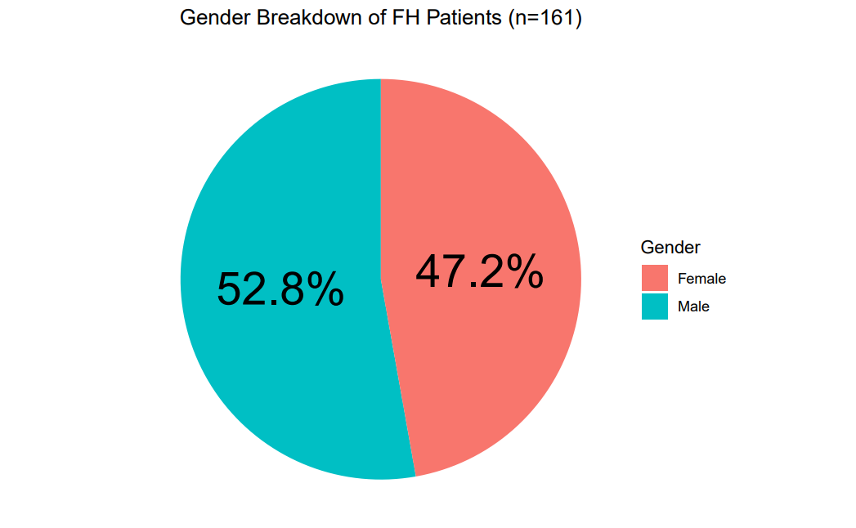
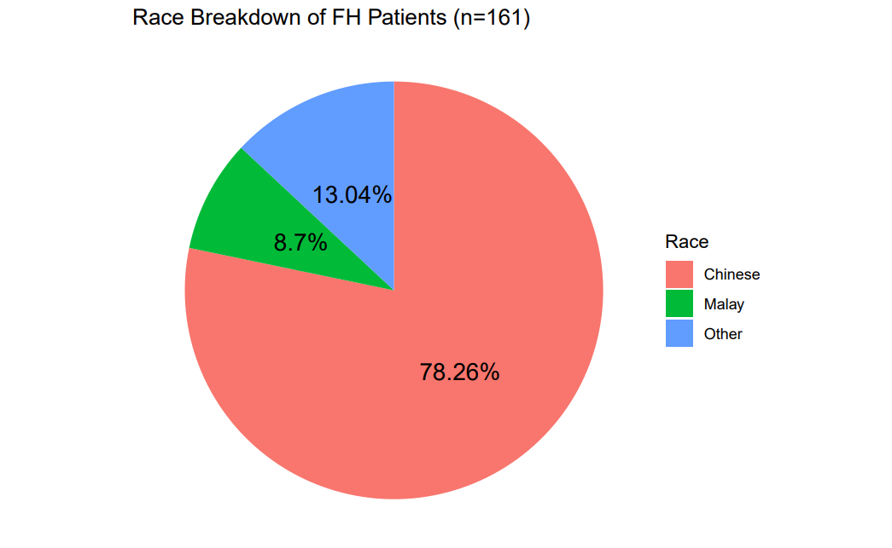
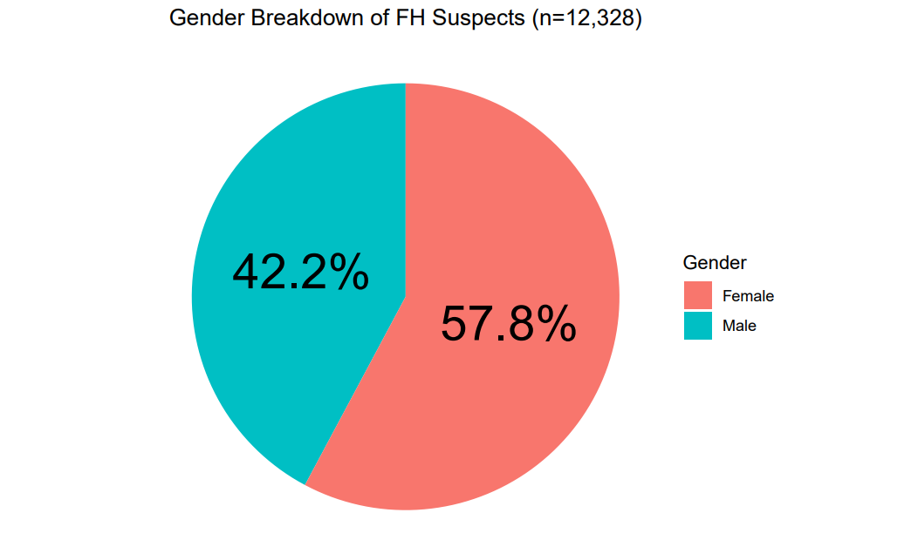
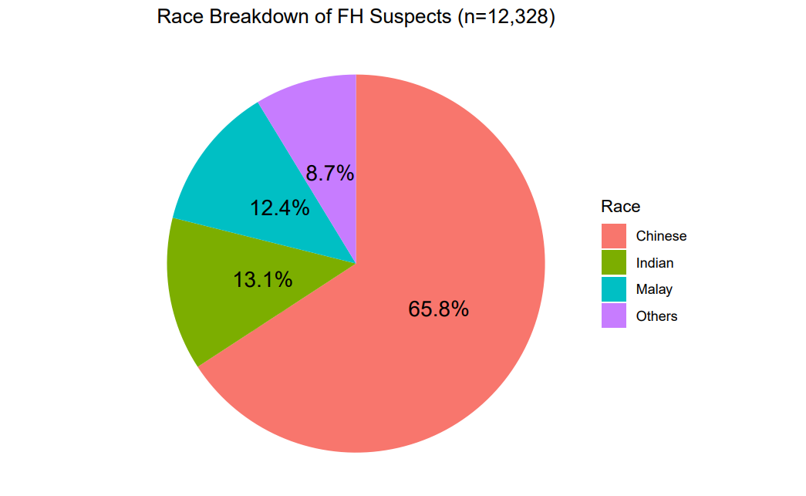
FH – Demographics
Can get more out of descriptive statistics when there are more observations
TP
Suspect

Slide 19
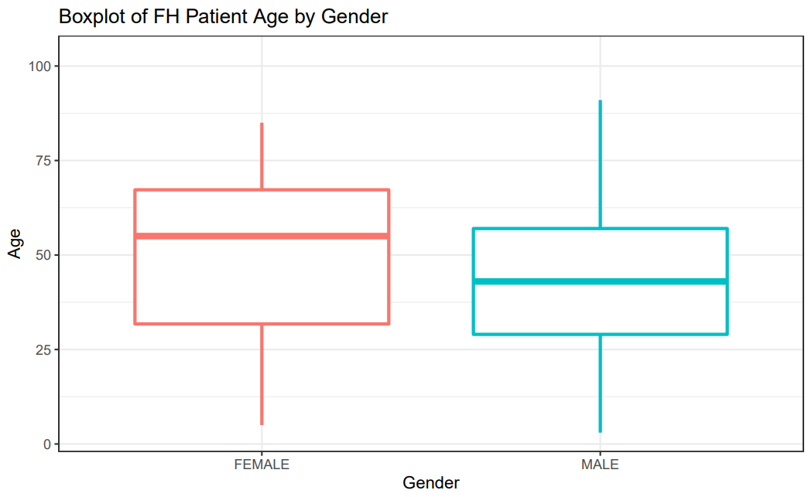
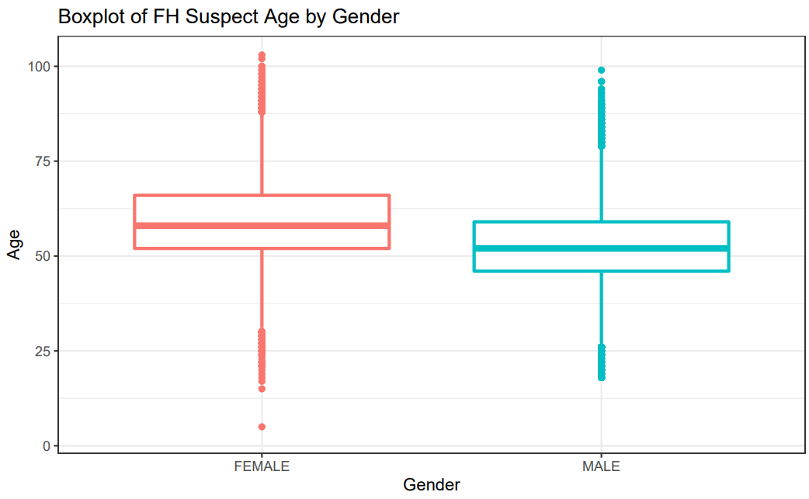
FH – Demographics

Slide 20
FH – Labs
Lab results are a good numeric indicator, with the potential to provide large volumes of data
Since there is a red flag concerning LDL-C levels, this was the result of interest
Useful to observe lab results for patents in each of the red flag cohorts
Each patient may have multiple lab results, so maximum values were used

Slide 21
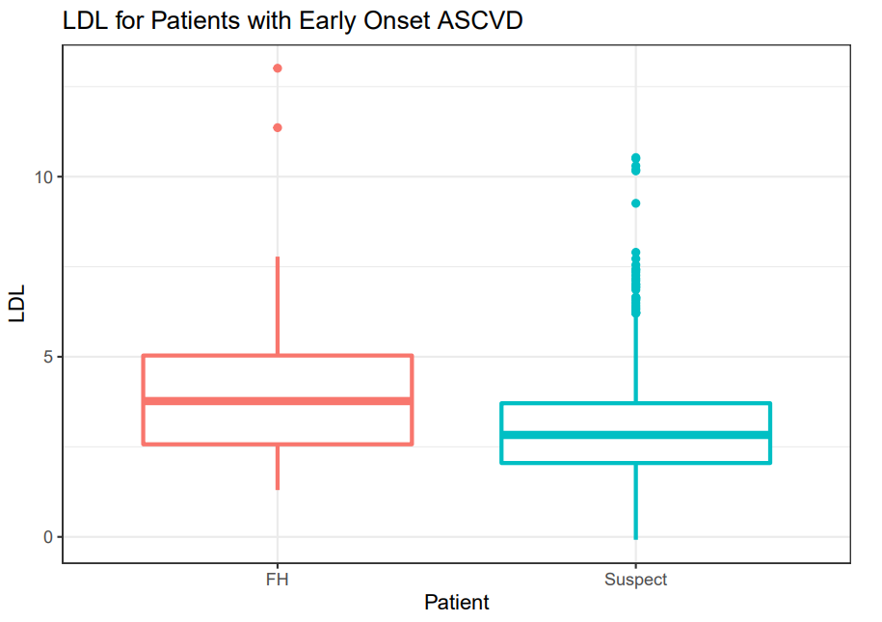
FH – Labs

Slide 22
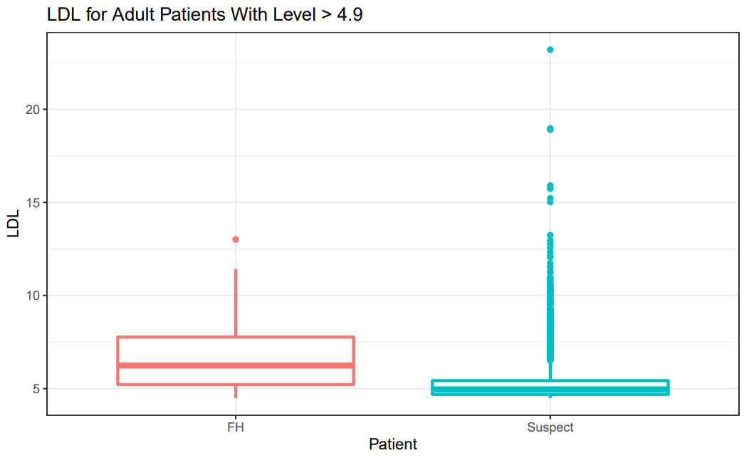
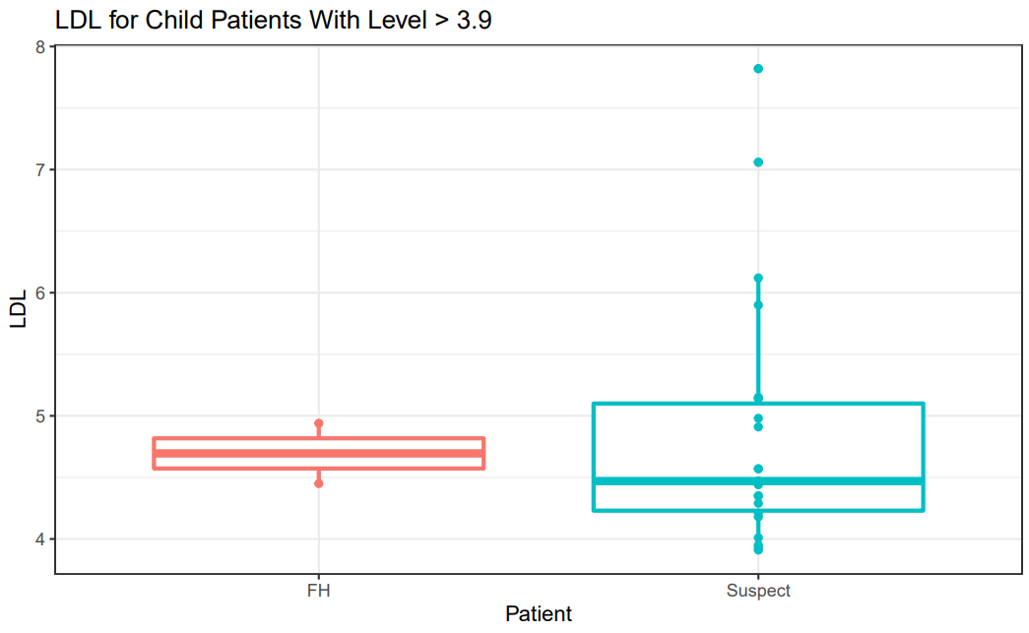
FH – Labs
Very few observations

Slide 23
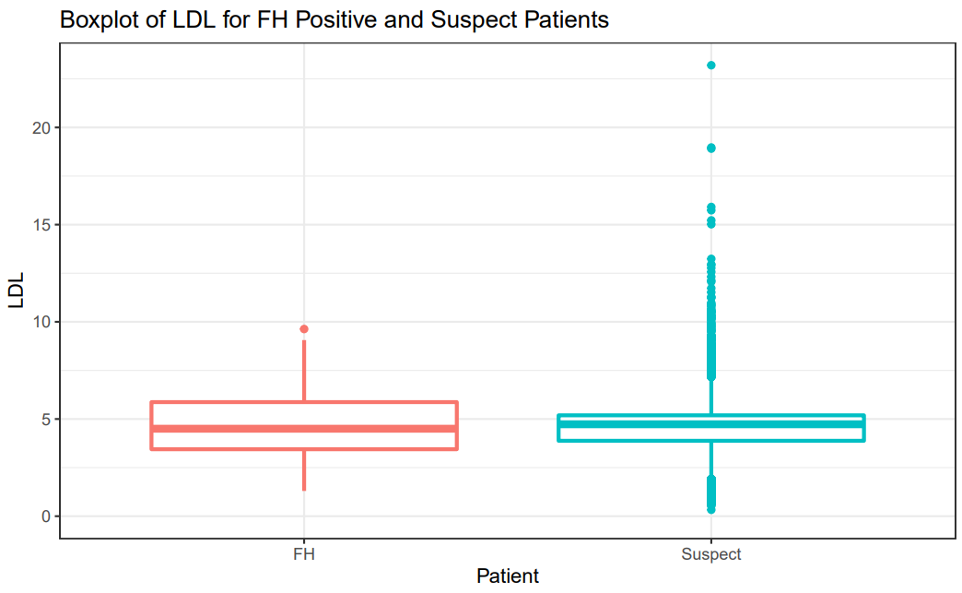
FH – Labs
Two sample t-test for difference in means
H0: There is no difference in means
HA: There is a difference in means
In this case, the null hypothesis is the desired scenario, as this would imply that the red flags are selecting patients that are similar to the TPs.
p=0.1022
Conclusion: At the 10% significance level, we fail to reject H0. There is insufficient evidence to suggest that the means differ.

Slide 24
FH – Cluster Analysis
Cluster analysis – unsupervised machine learning that groups instances into clusters based on their similarity
Can examine these clusters to see which cohorts of patients are similar, and what they have in common
Used 4 attributes for clustering
Age
Race
Gender
LDL-C
Partition around medoids (PAM) clustering method

Slide 25
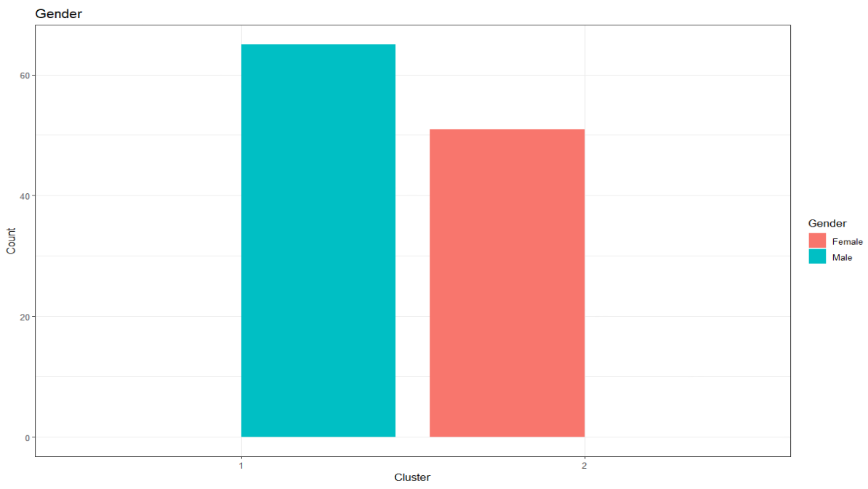
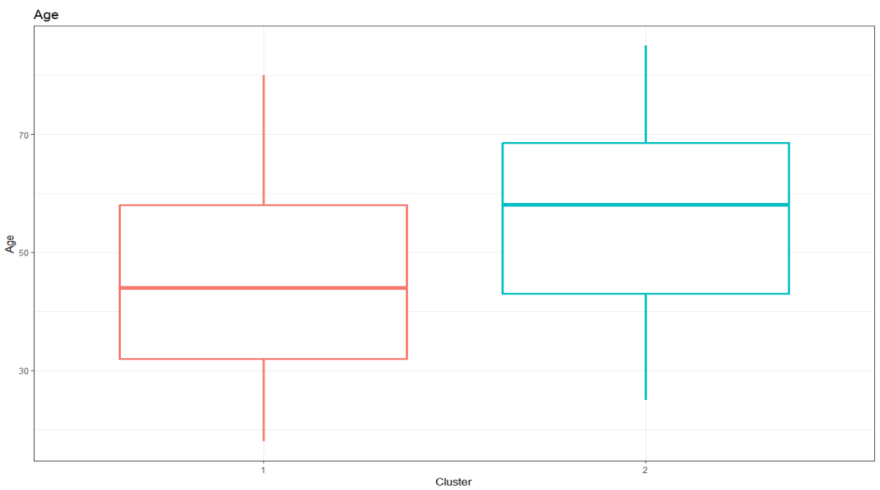
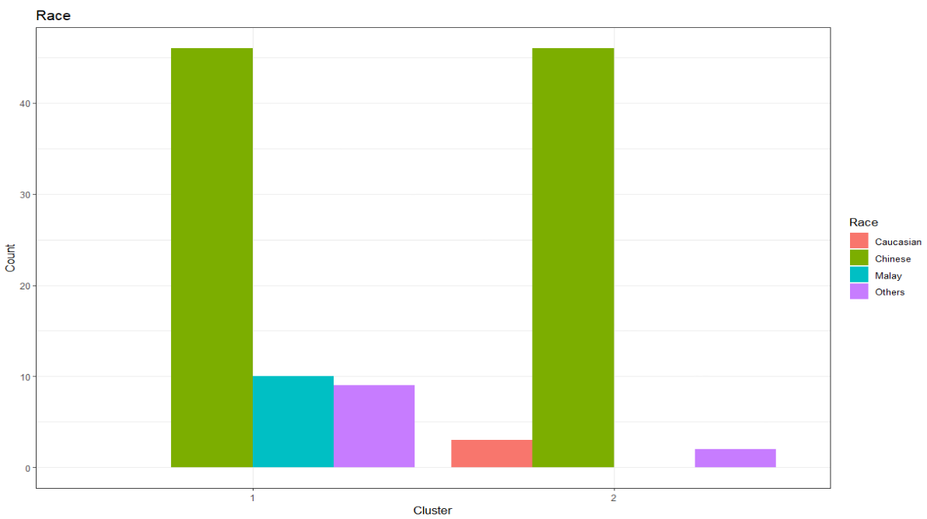
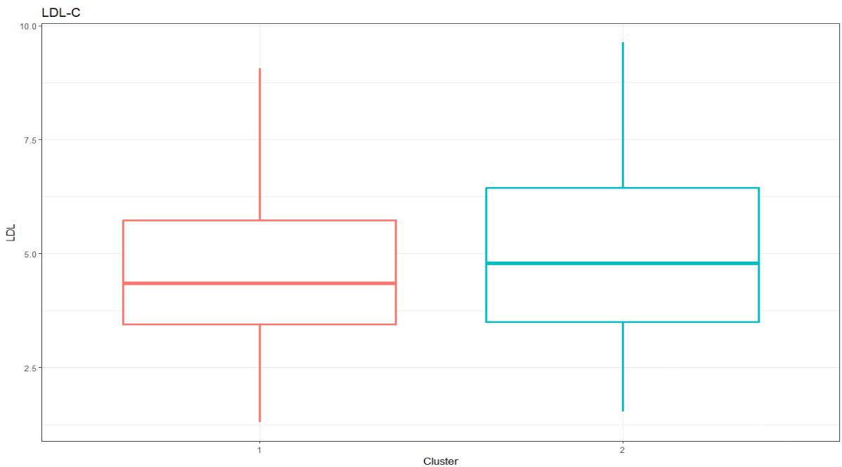
FH – Cluster Analysis, k=2

Slide 26
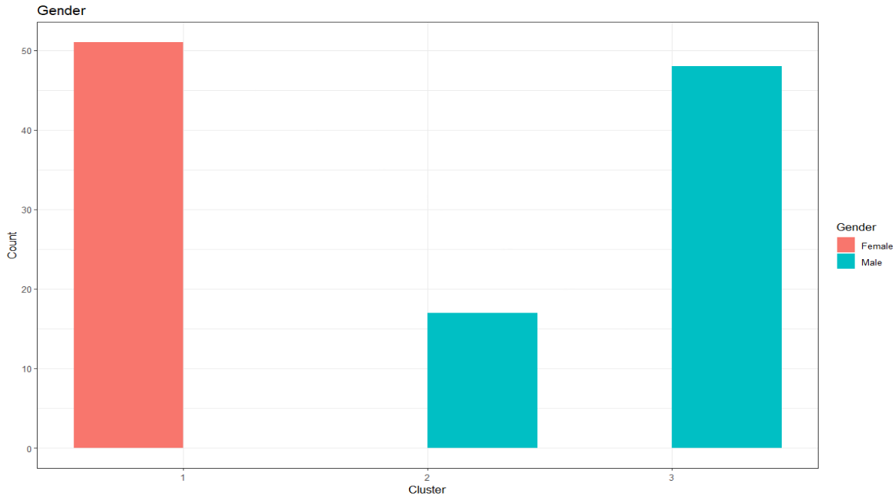
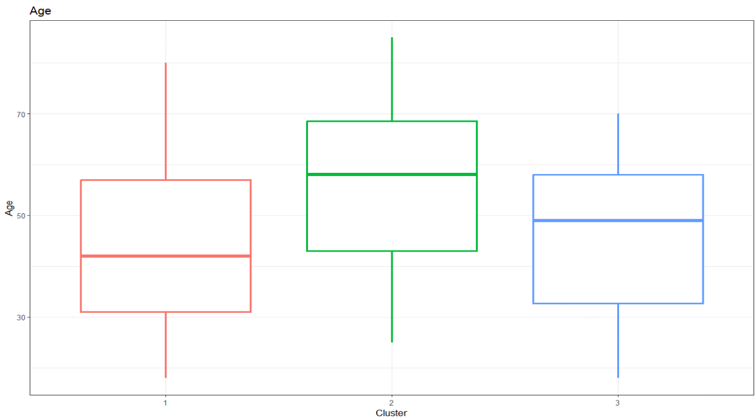
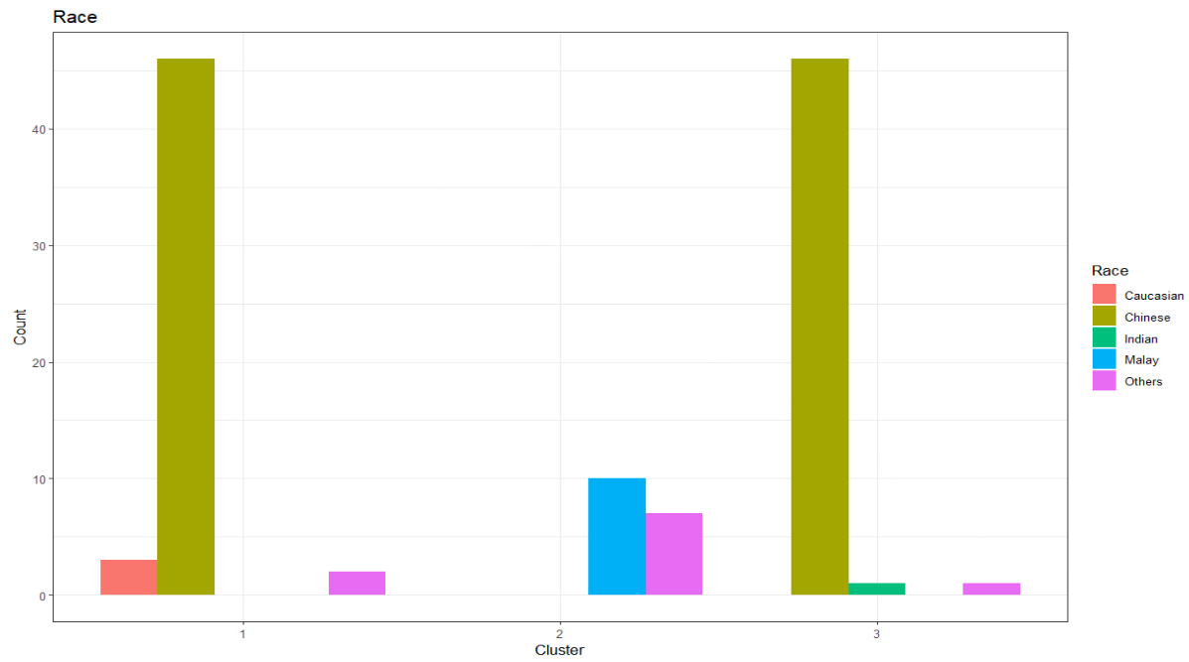
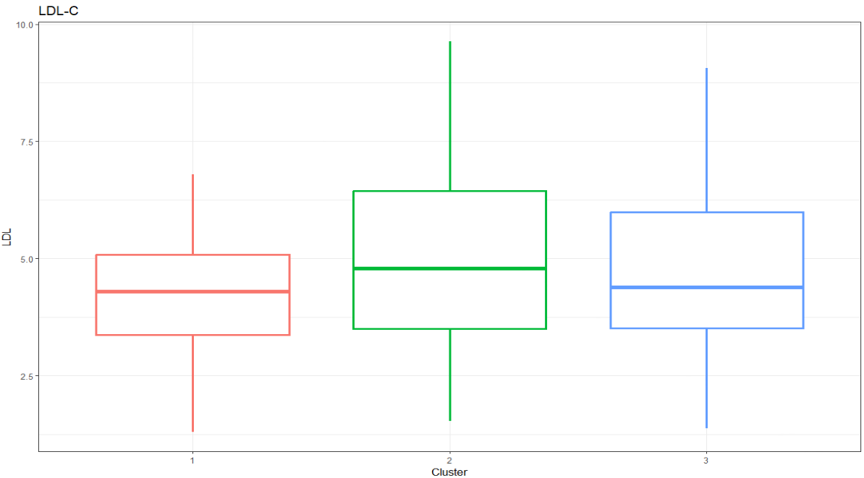
FH– Cluster Analysis, k=3

Slide 27
FH – Limitations
Better analysis than Fabry, but still plenty of room for improvement
Sparse data
Not all TPs/suspects have lab results
Presence of true negatives (TNs) would allow for more sophisticated machine learning such as data classification

Slide 28
Future Work
Cross-discipline communication is vital
Get more data
More TPs and TNs
Use more metrics in analyses (other labs, imaging results, drug data)
More data = better healthcare outcomes

Slide 29
Acknowledgements
Dr Saumya Jamuar
Dr Ritu Gupta
Mr Sean Monaco
Ms Sylvia Kam
Ms Lim Jiin Ying
Ms Jasmine Goh
Dr Sonia Davila
Dr Lim Weng Khong
Ms Yasmin Bylstra
Ms Simone Ng
Dr K K Yeo
Mr Too Cheung Weng
Mr Mark Heng
Mr Zhang Yanxiang
Mr Joel Ang Wee Keat
Data funding source: Sanofi

Slide 30

Thank You
daniel.moynihan@student.curtin.edu.au
Daniel Moynihan

Slide 31
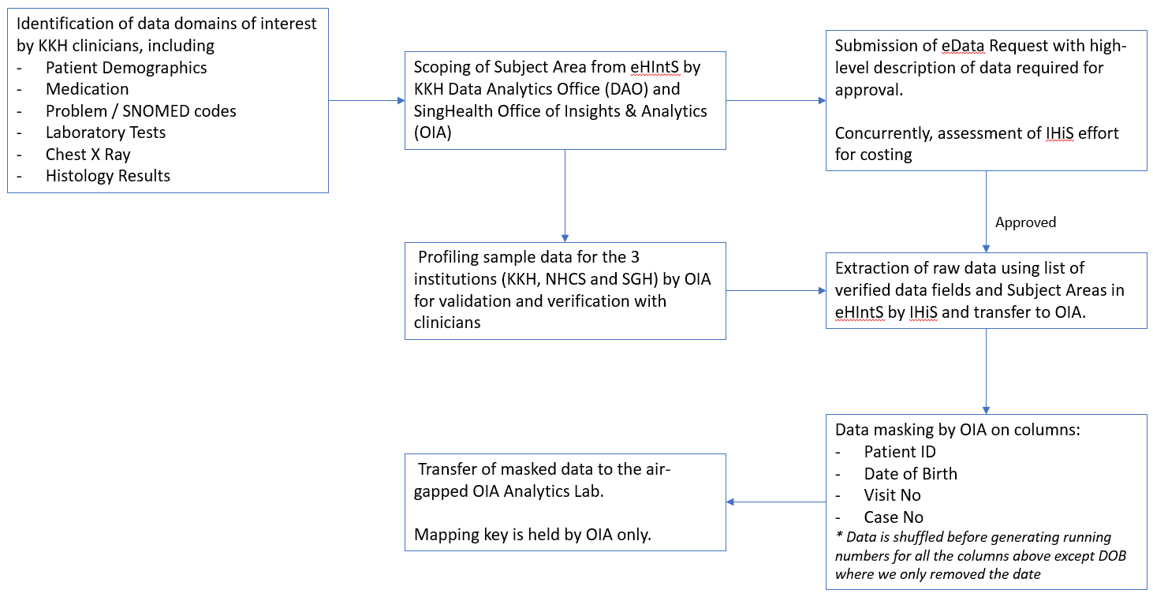
Appendix 1 – Data Collection Process

Slide 32
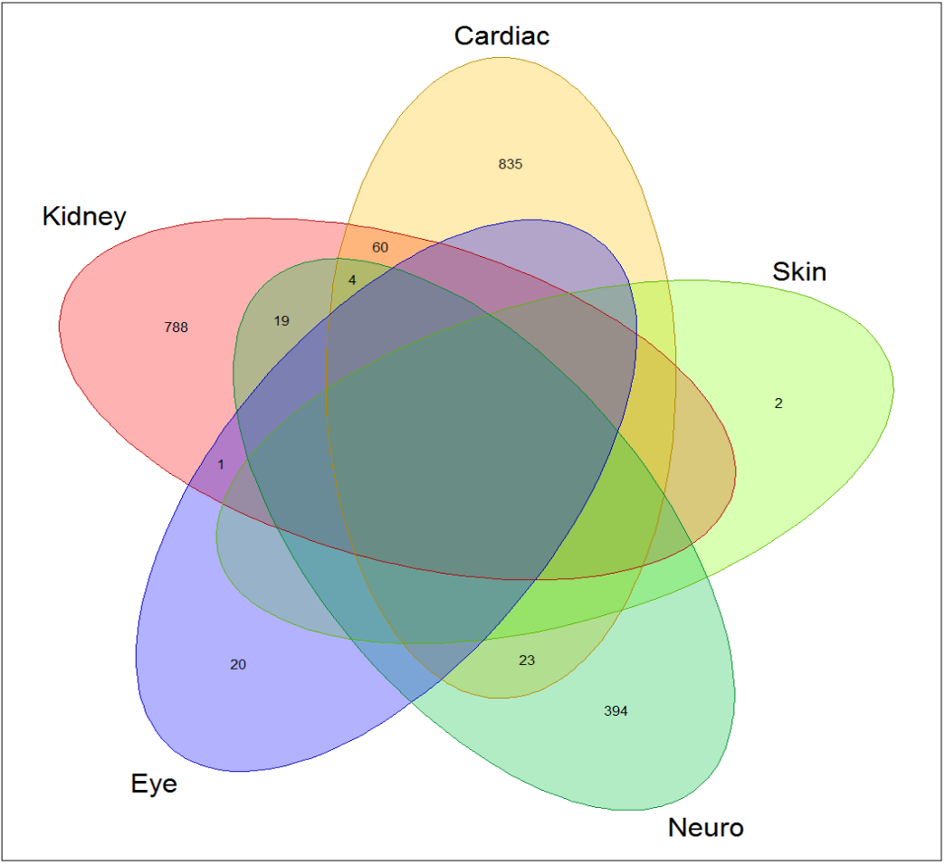
Appendix 2 – Fabry Systems Interaction Venn Diagram

Slide 33
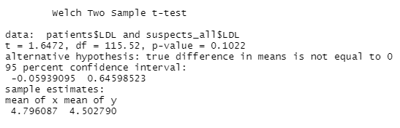
Appendix 3 – Two sample t-test R output

